Slide 1



Bienenkonigin
Mikhaela Mueller, Meredith Hogue, Minu Perera, Narbada Acharya, Jack hickey

Slide 2
agenda
Problems/Possible Solutions for Cardinal Cupboard
Analysis – Use-Case example and diagram
Prototypes
Conclusion

Slide 3


problems/ Possible solutions
Website is not very user-friendly​
Lackluster​
Images/Videos​
Mission Statement​
Social Media​
Missing a “call to action” – encouragement to donors​
Sponsors​
Impact​
No Separate login for employees​
Inventory tracking​
Employee access to specific links

Slide 4
Use cases
Definition
Represents a major business process that the system will perform that benefits the actor(s) in some manner
An actor represents a role that a user of the system plays

Slide 5
Donation tracking form
Form filled out by staff that will keep record of items donated by guests
Main Flow
Employee inputs Name
Employee records Date Received
Employee records Items Received
Employee records Weight in Pounds
Employee records Who Donated (may also leave as Anonymous)
Employee selects Receiving Method (By Hand, Donation Box, etc.)
Employee hits submit

Slide 6
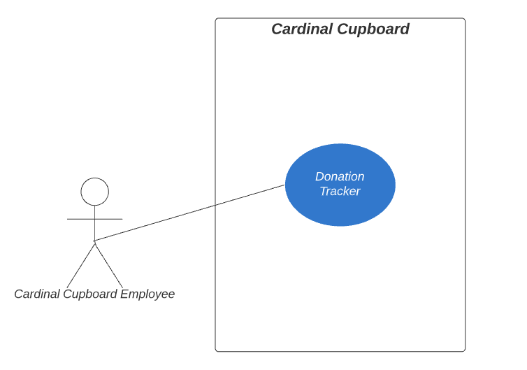
use case diagram

Slide 7
prototypes

Slide 8
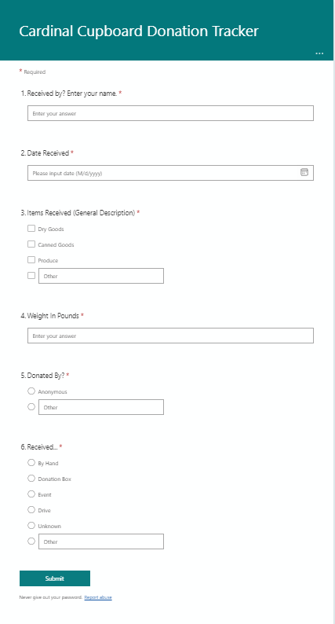
Prototype 1 Donation Tracker

Slide 9
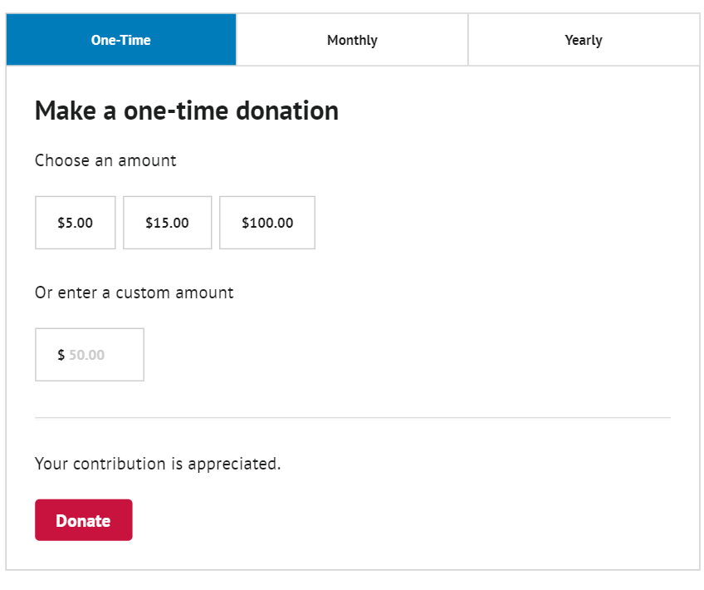
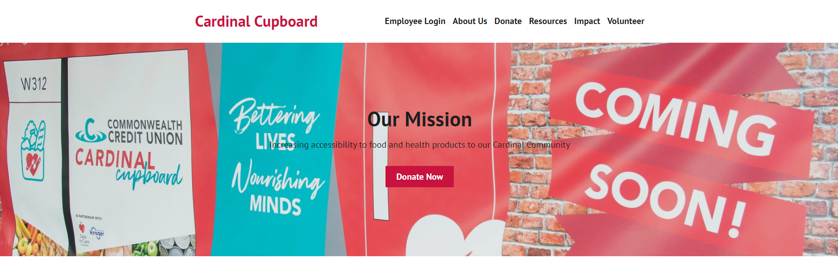
Prototype 2 – Monetary Donation

Slide 10
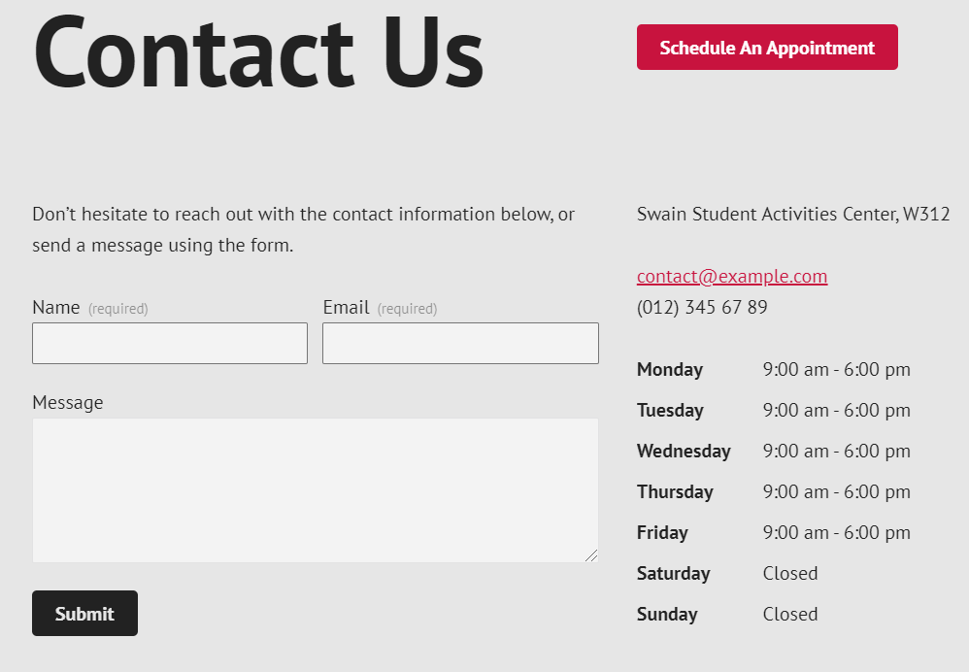
Prototype 3 – Contact Us

Slide 11
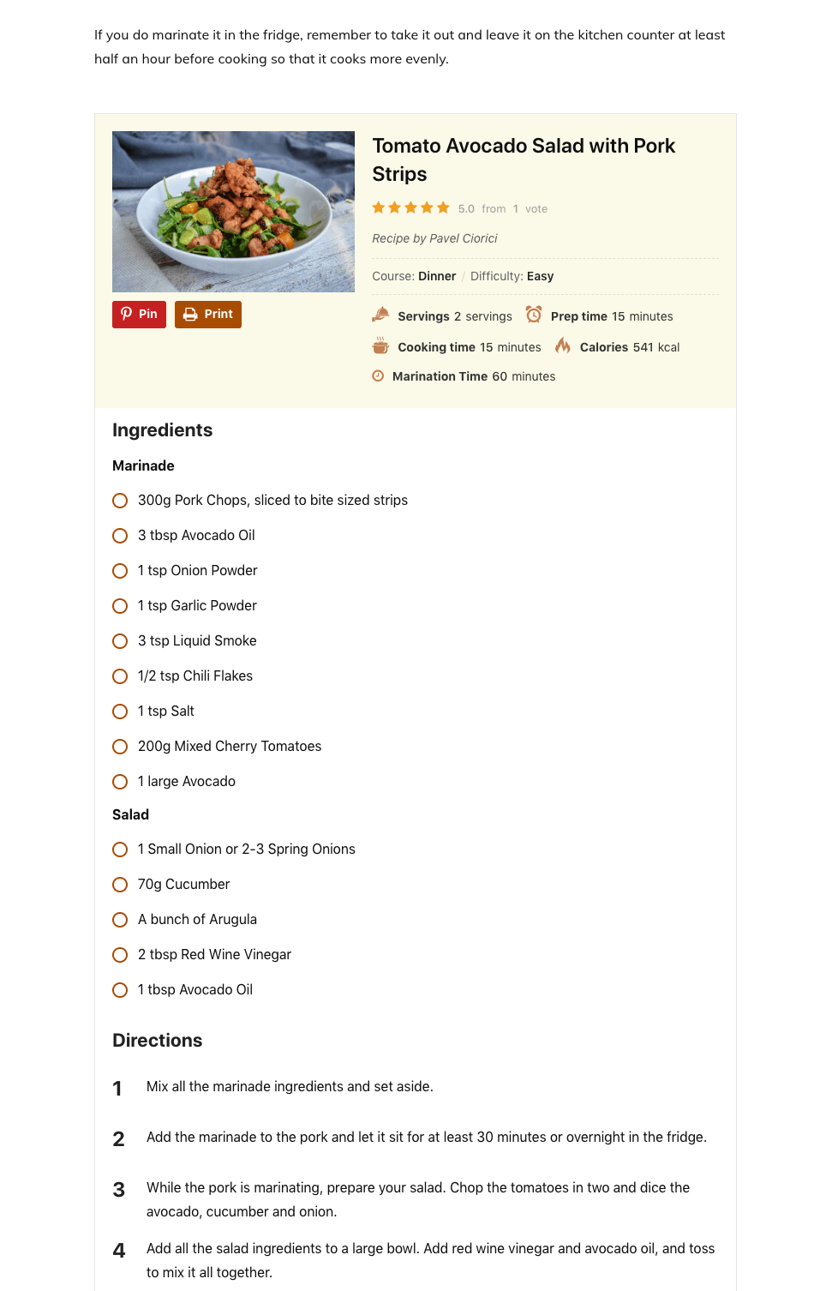
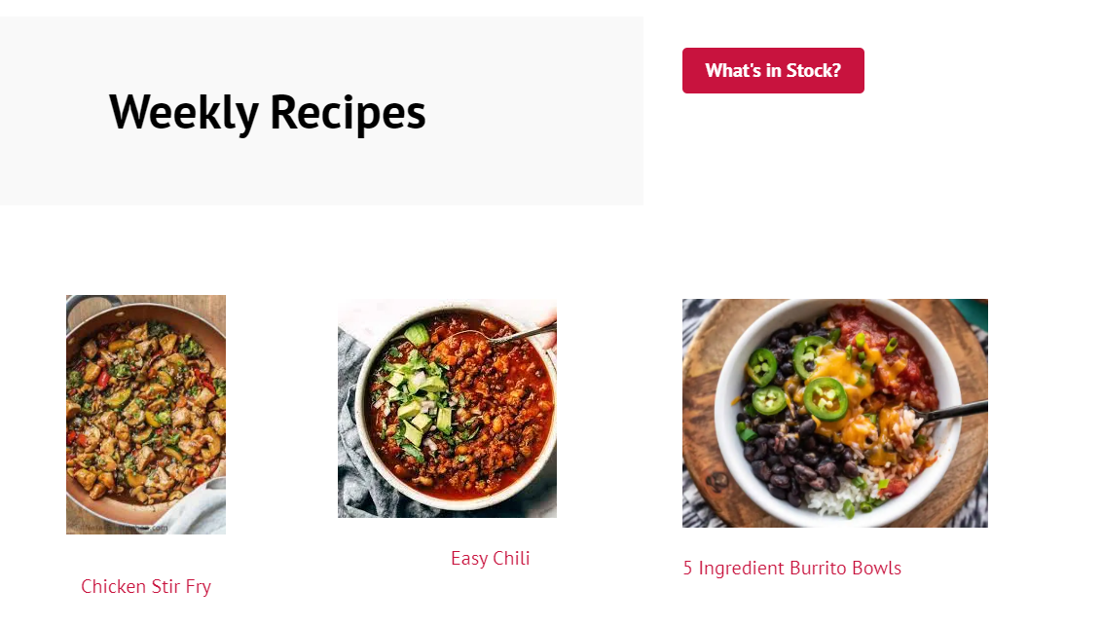
Prototype 4 - Recipes
Plugin available for WordPress that allows an entry of recipes
Could have user select ingredients that are in stock
Plugin would generate a recipe for the user

Slide 12
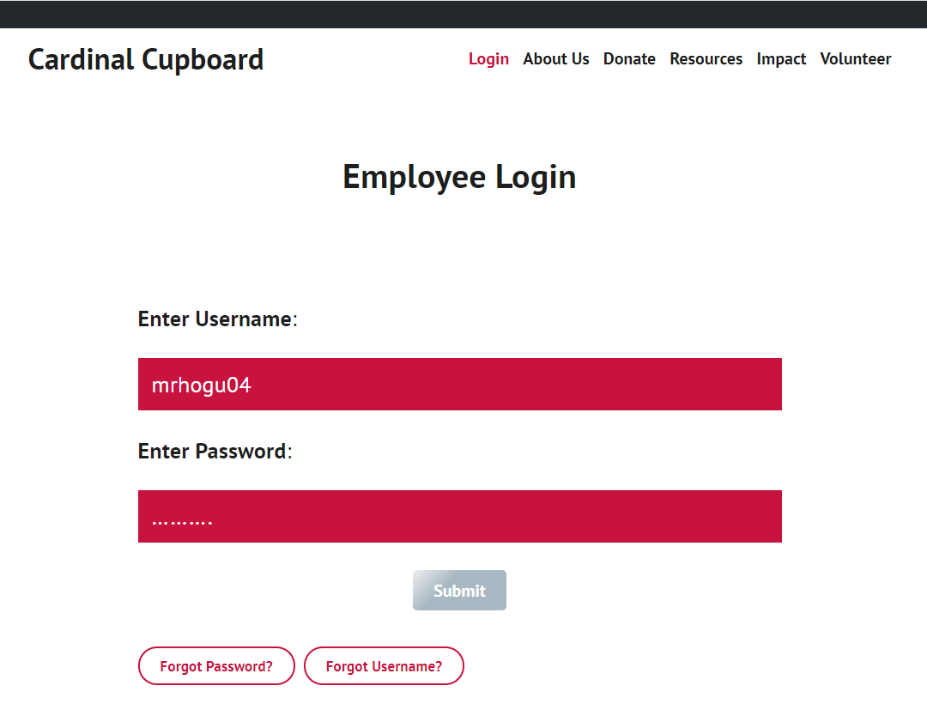
Prototype 5 – Login Page

Slide 13
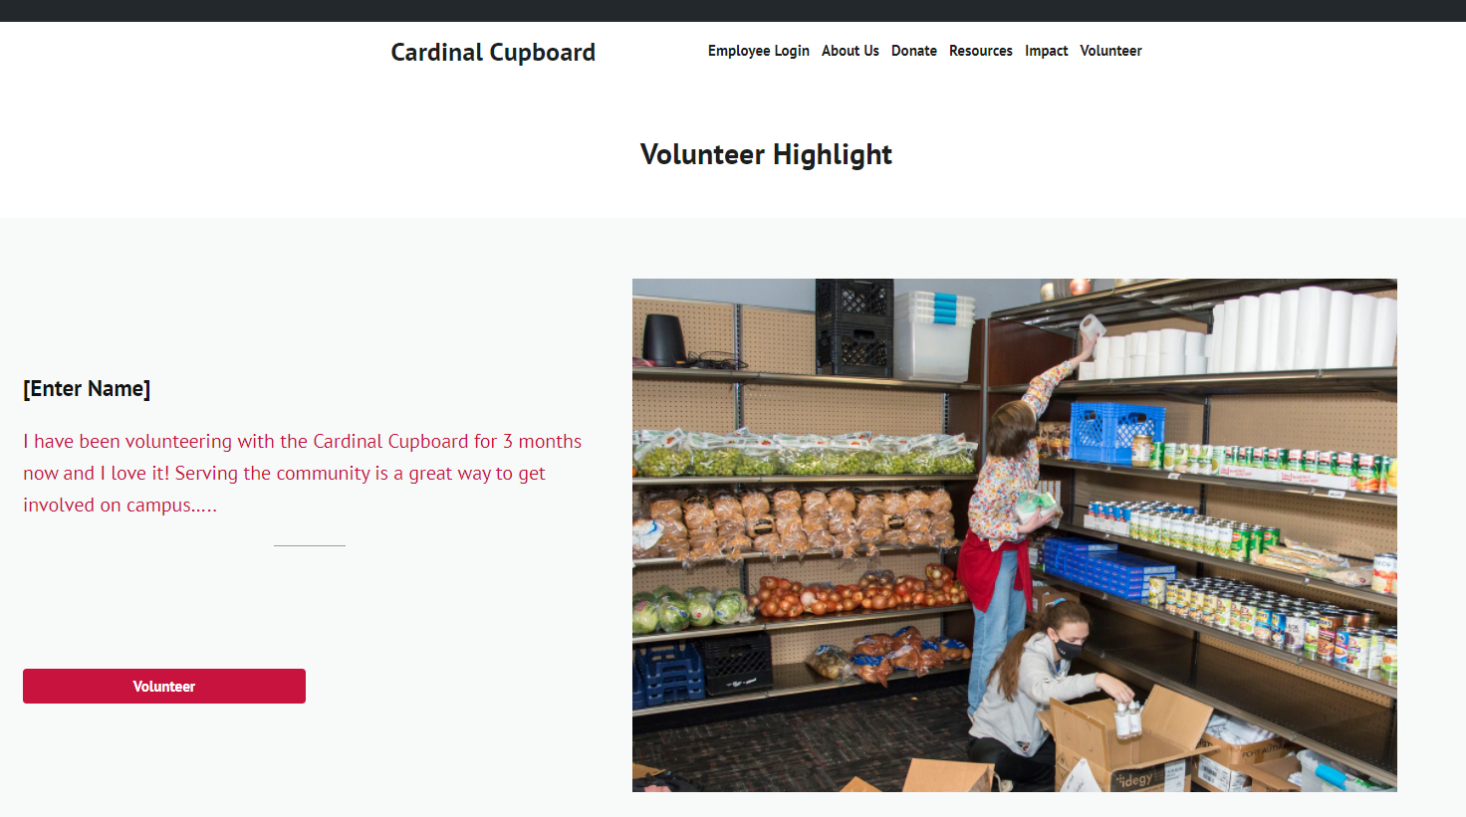
Prototype 6 - Volunteer highlight

Slide 14
summary
Missing the "Call to Action“
Prototypes are a way to solve the current issues
Meant to encourage the users to engage with the site as much as possible
Donate/Volunteer
Give Information - forms
Receive Information – resources
Leave knowing WHO the Cardinal Cupboard is, and WHAT they do

Slide 15

Thank you! Any questions?

